Slide 1
Appendix
City Data

Slide 2
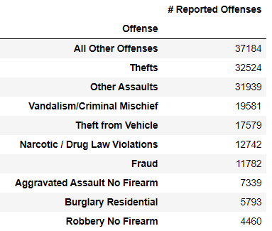
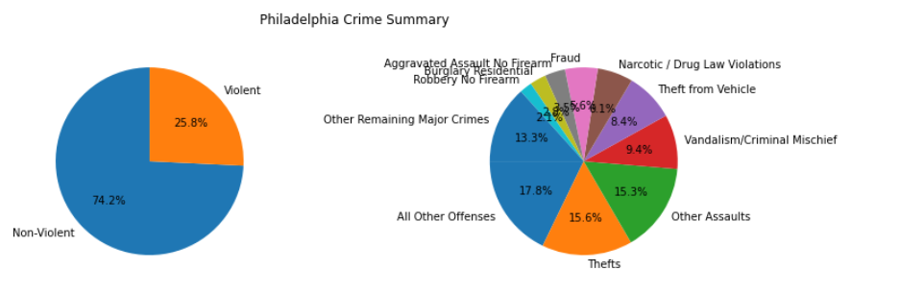
Philadelphia – Overview of Crime by Offense
Source data and cleaning efforts
Source: https://www.opendataphilly.org/dataset/crime-incidents/resource/a2373b85-408b-4144-84e9-cb24843e5f2b
During the period of this analysis (March 1, 2019 through June 30, 2020), Philadelphia experienced roughly 210,000 crimes, or 460 crimes per day

Slide 3
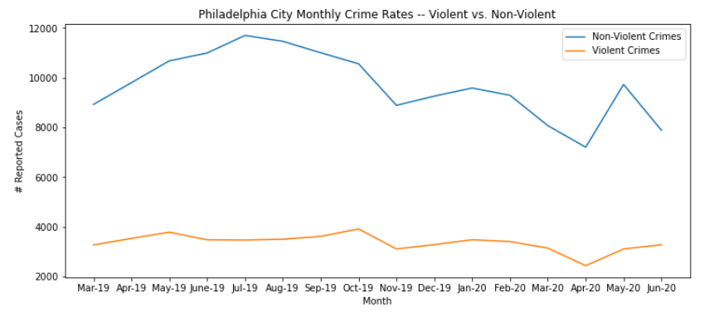
Philadelphia Crime Trends – Violent vs. Non-Violent
Philadelphia’s crime rates show a downtrend for both violent and non-violent crimes since October, 2019.
The downtrend from February 2020 into May 2020 can be attributed to federal and state mandated lockdowns
The spike in May for violent and non-violent crime may be due to the widespread national protest rallies seen in many major cities.
With only 16 months of data, it is not possible to draw any conclusions around seasonality.

Slide 4
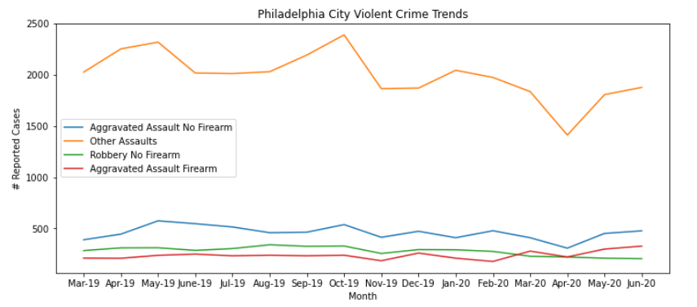
Philadelphia Crime Trends – Violent Crimes by Offense Type
Again, there is a noticeable downtrend from October 2020 in some of the top violent crimes and this trend is disrupted in May / June 2020 with a spike upward due to ease of lockdown and the national protests happening in major cities during this time period
The only exception, noted, in this graph is “Robbery – No Firearm” crimes did maintain a trend downward through May / June 2020

